Slide 1
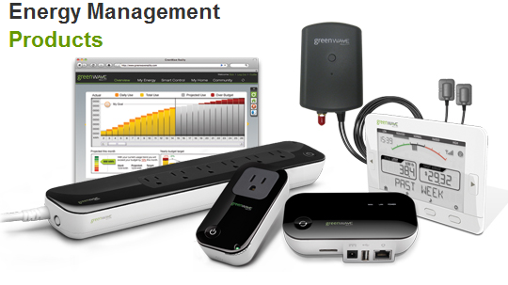
EMS Team Meeting
Johnny Nguyen
Camilo Aguilar
Christian Goldau
Andrew Wang
March 18, 2013

Slide 2
Milestones-This Quarter
Real time, wireless display.
Improving the code
More devices, more waveform features

Slide 3
FFT Code vs DFT (revisited)
N² vs N * log₂ N
Significant time saved
Cooley–Tukey FFT algorithm
Demo sends every 8 seconds, would significantly increase speed
DFT
Size of Array | Time (s)
128 | 17.6
64 | 4.8
32 | 1,3
FFT
Size of Array | Time (s)
512 | 1.3

Slide 4

Waveform Features-Area (Andrew Wang)
Area per period
Time it takes to reach half the area

